Slide 1
Master-Thesis Methodical Approach for Analyzing Process Parameters and Optimizing Boundary Conditions in Multi-Axis Robot Programs
Status Update: Week 10 (13 weeks left)
11.12.2023 – 17.12.2023
Jan Nalivaika

Slide 2
State of the Art / Methodology Questions
Continuous-path mode ???
Changes: -
-
-
-
G-Code ??
Add / No Add
Methodology:
-
-
-
-
-

Slide 3
ToDo
- Swarm weiter testen
- Berechnung prüfen = DONE
- Größerer wertebereich = DONE
- Gröbere Werkzeugbahn = DONE

Slide 4
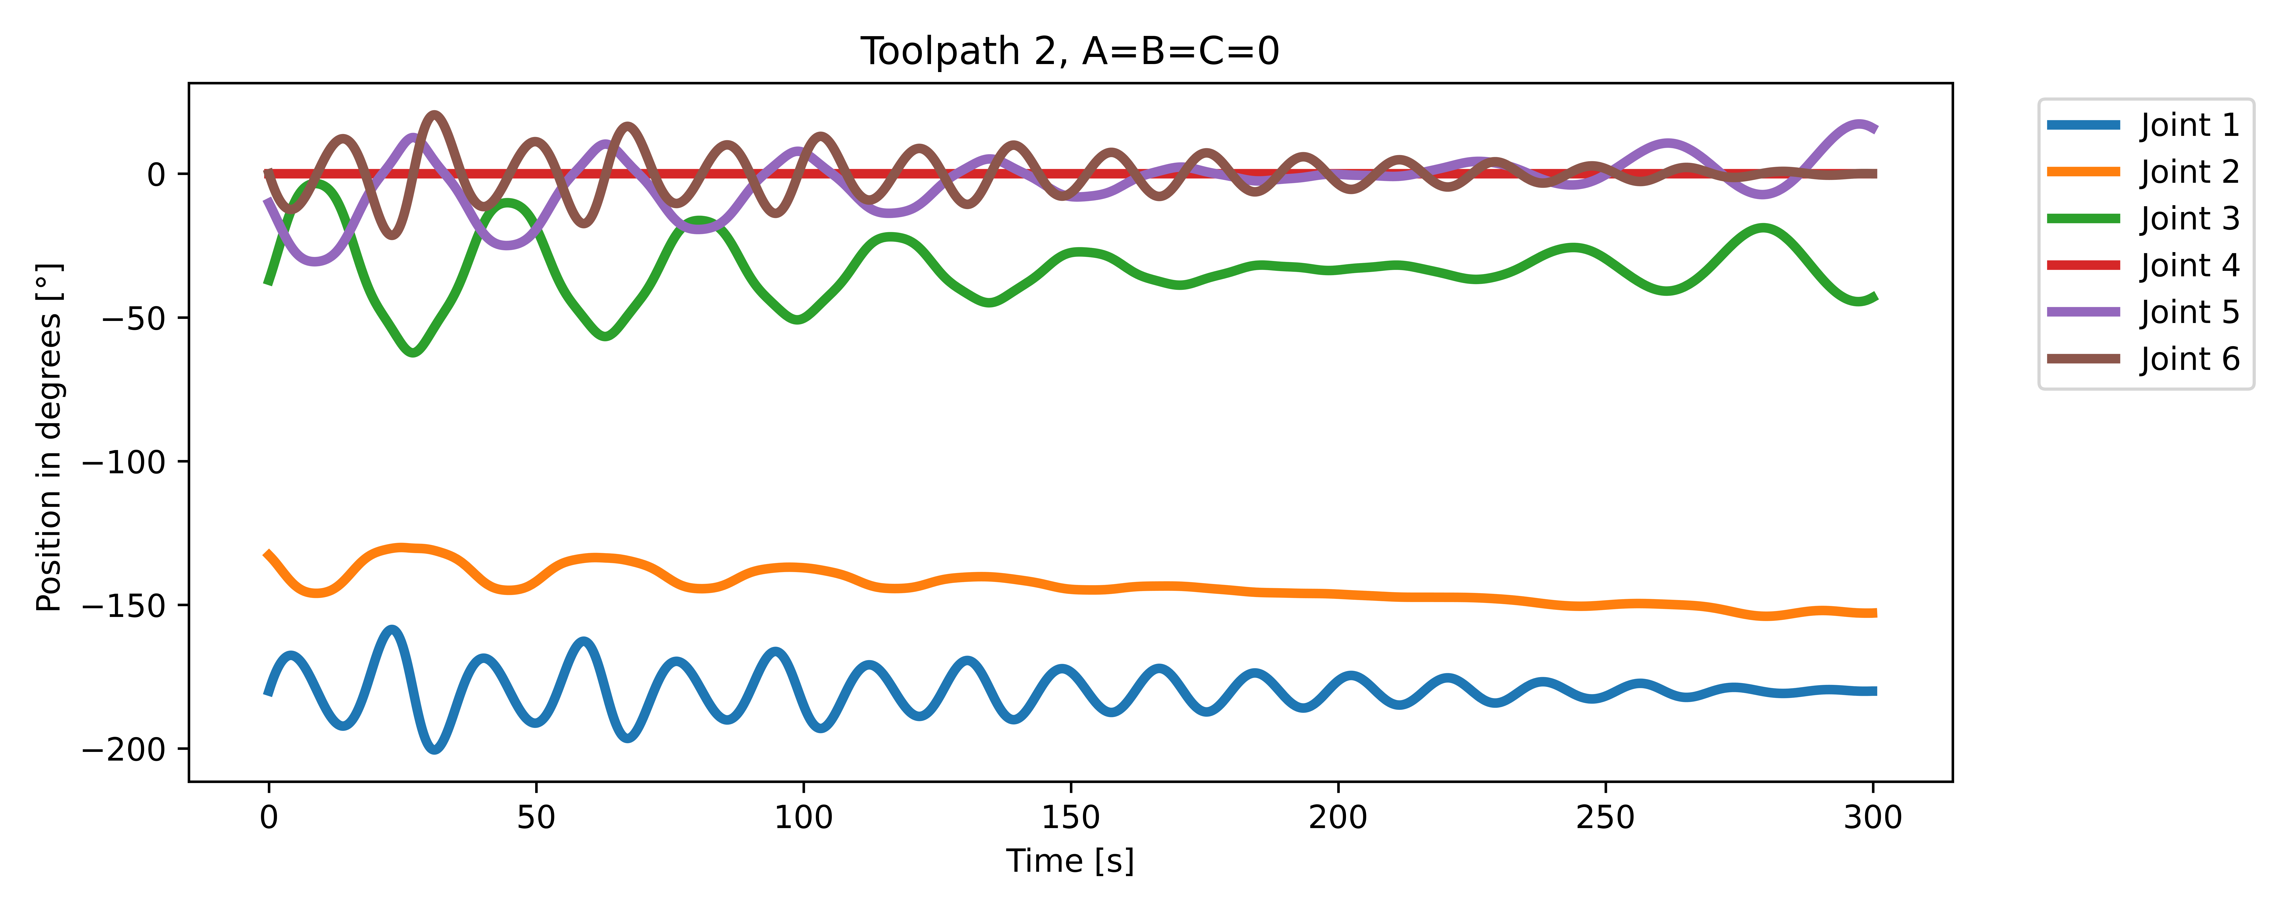
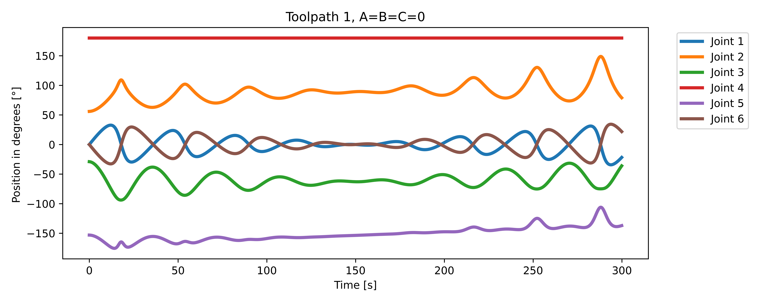
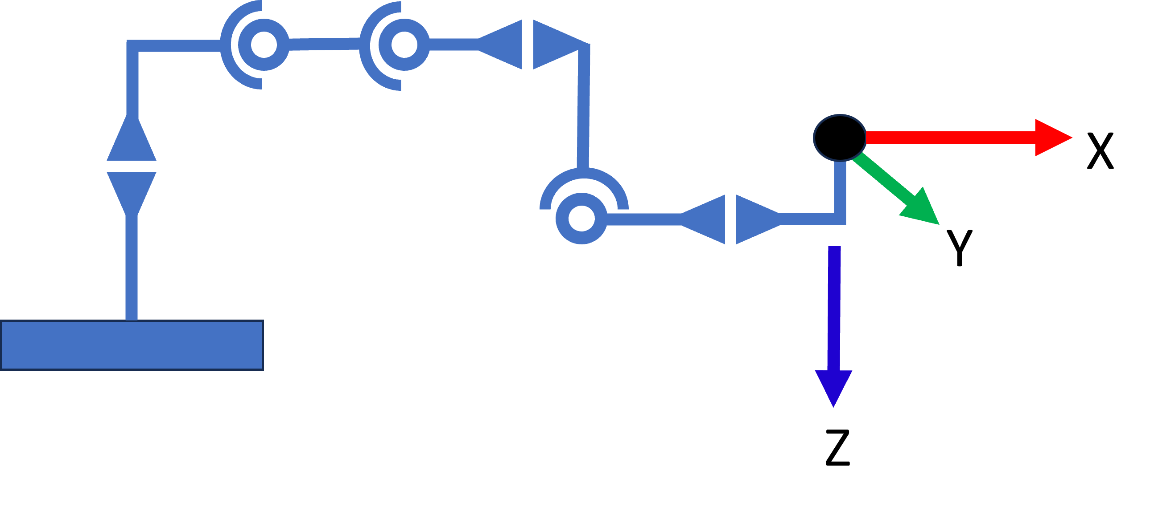
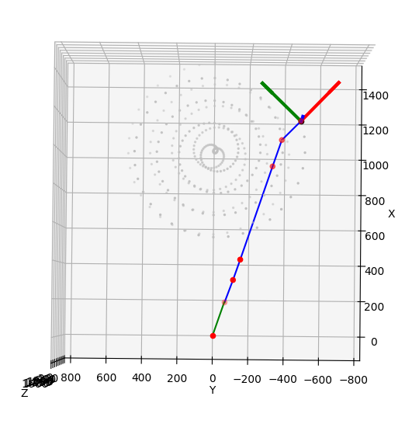
Why 180:
[WRONG]
Always in line with joint 1

Slide 5
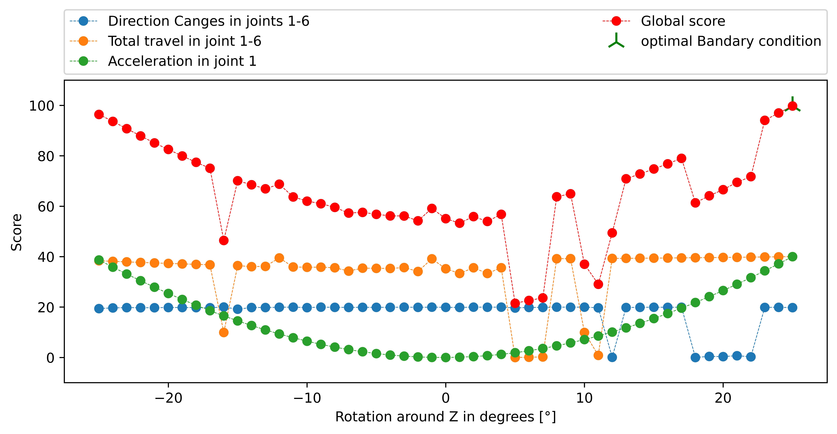
Why Jumping ???
Toolpath 1
-18
-17
-16

Slide 6
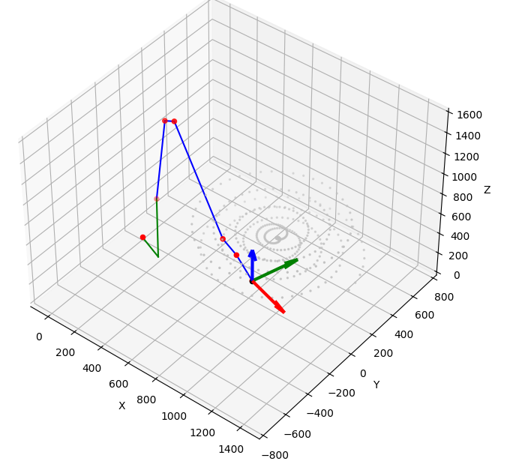
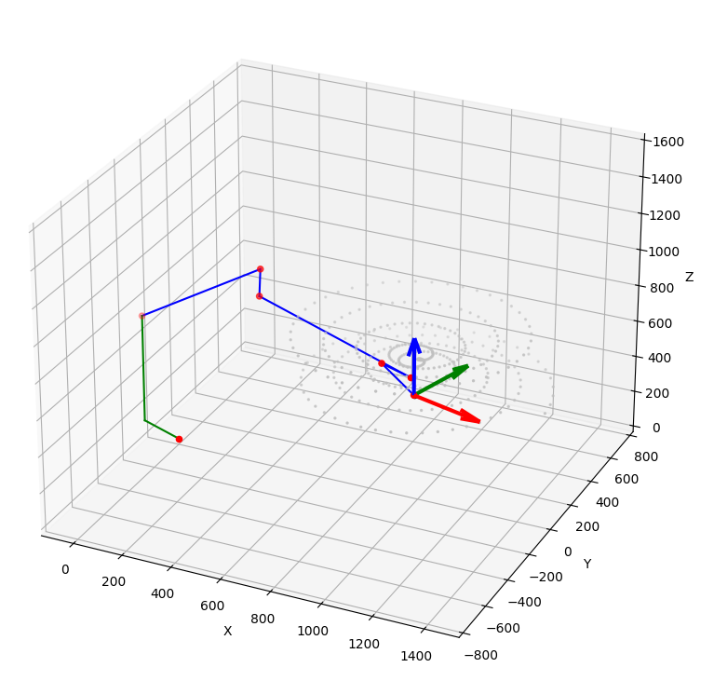
-17 vs -16

Slide 7
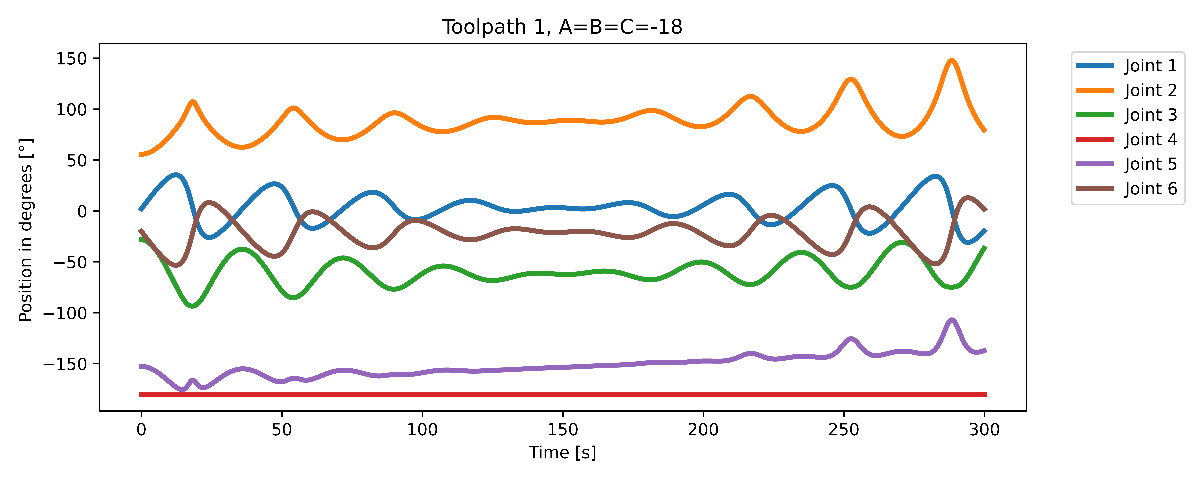
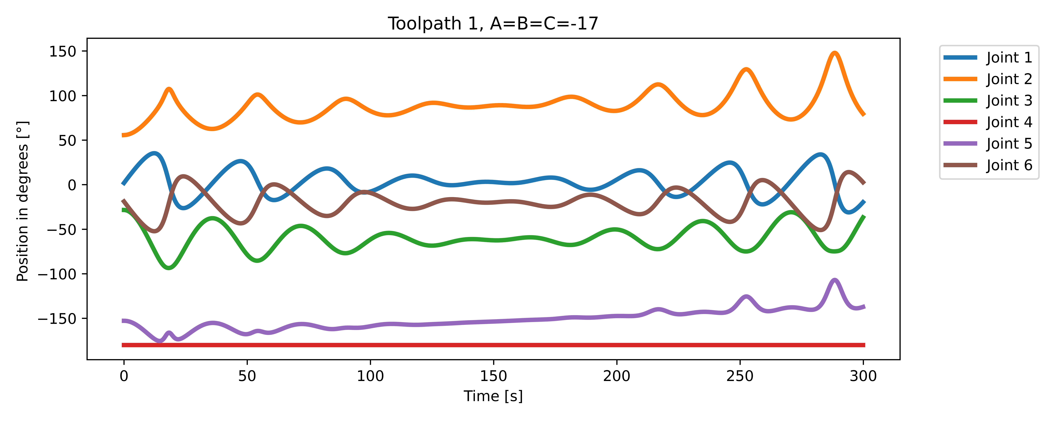
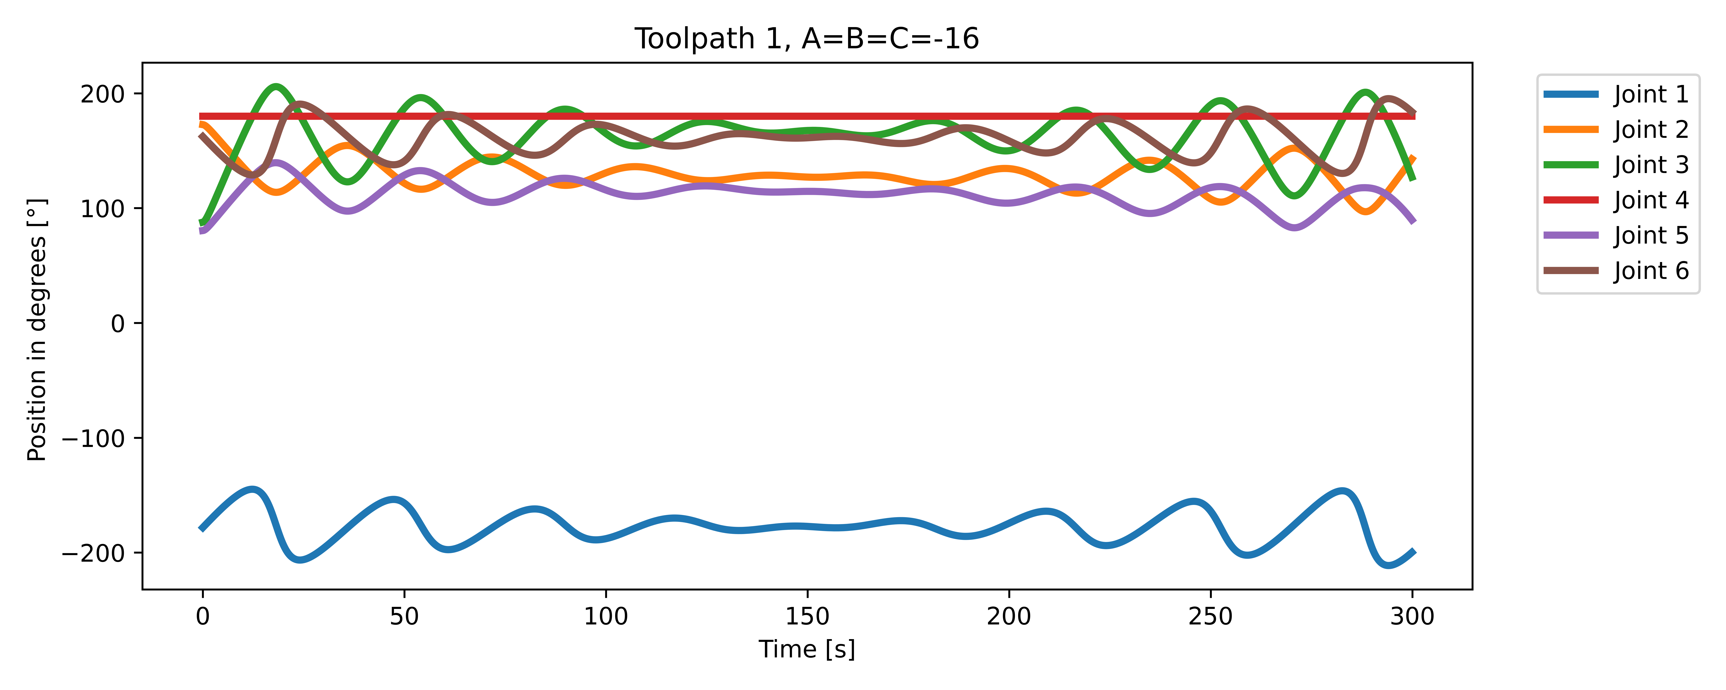
Solution:
Start inverse kinematics from
defined position
RAD is not DEG lol

Slide 8
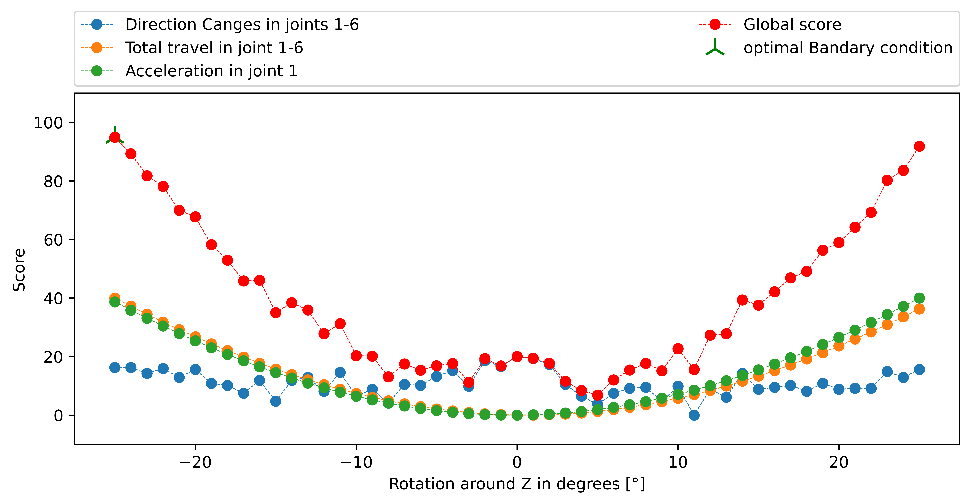
Result
Cool!
But why direction changes ??
Because 180 is not equal to 179.999999997! Solution: Added rounding to 3 decimals
☺

Slide 9
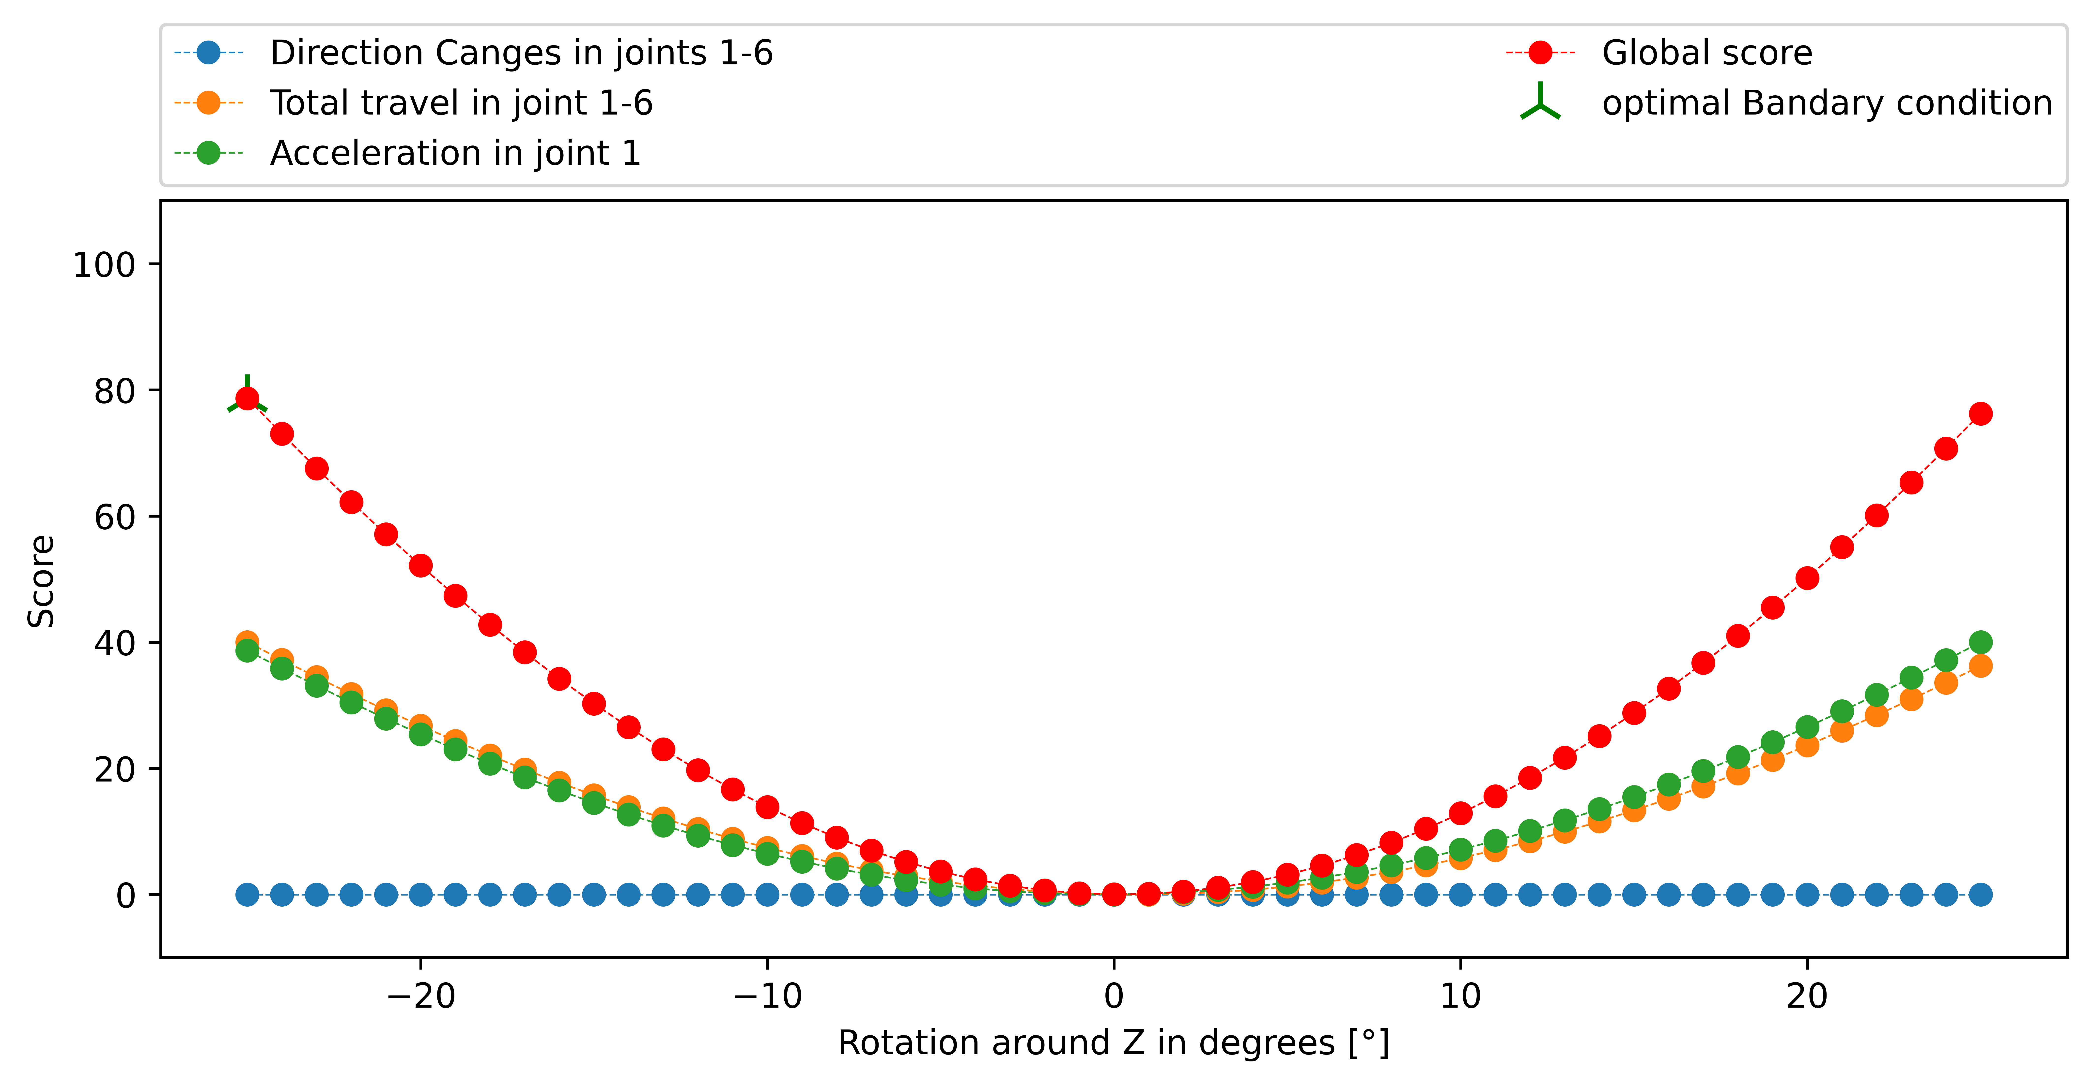
Solution !!!

Slide 10
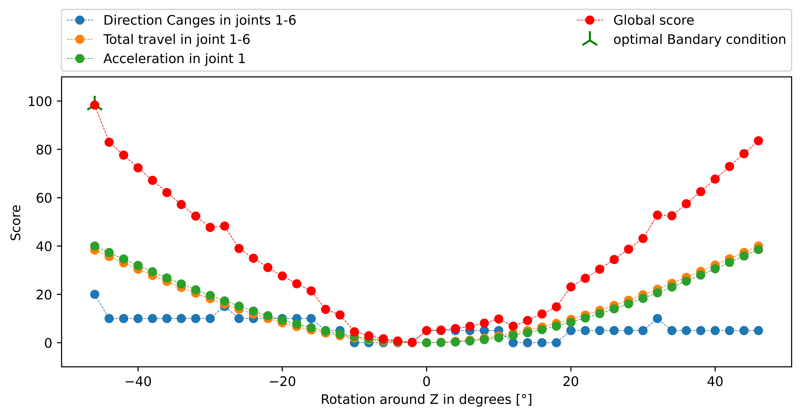
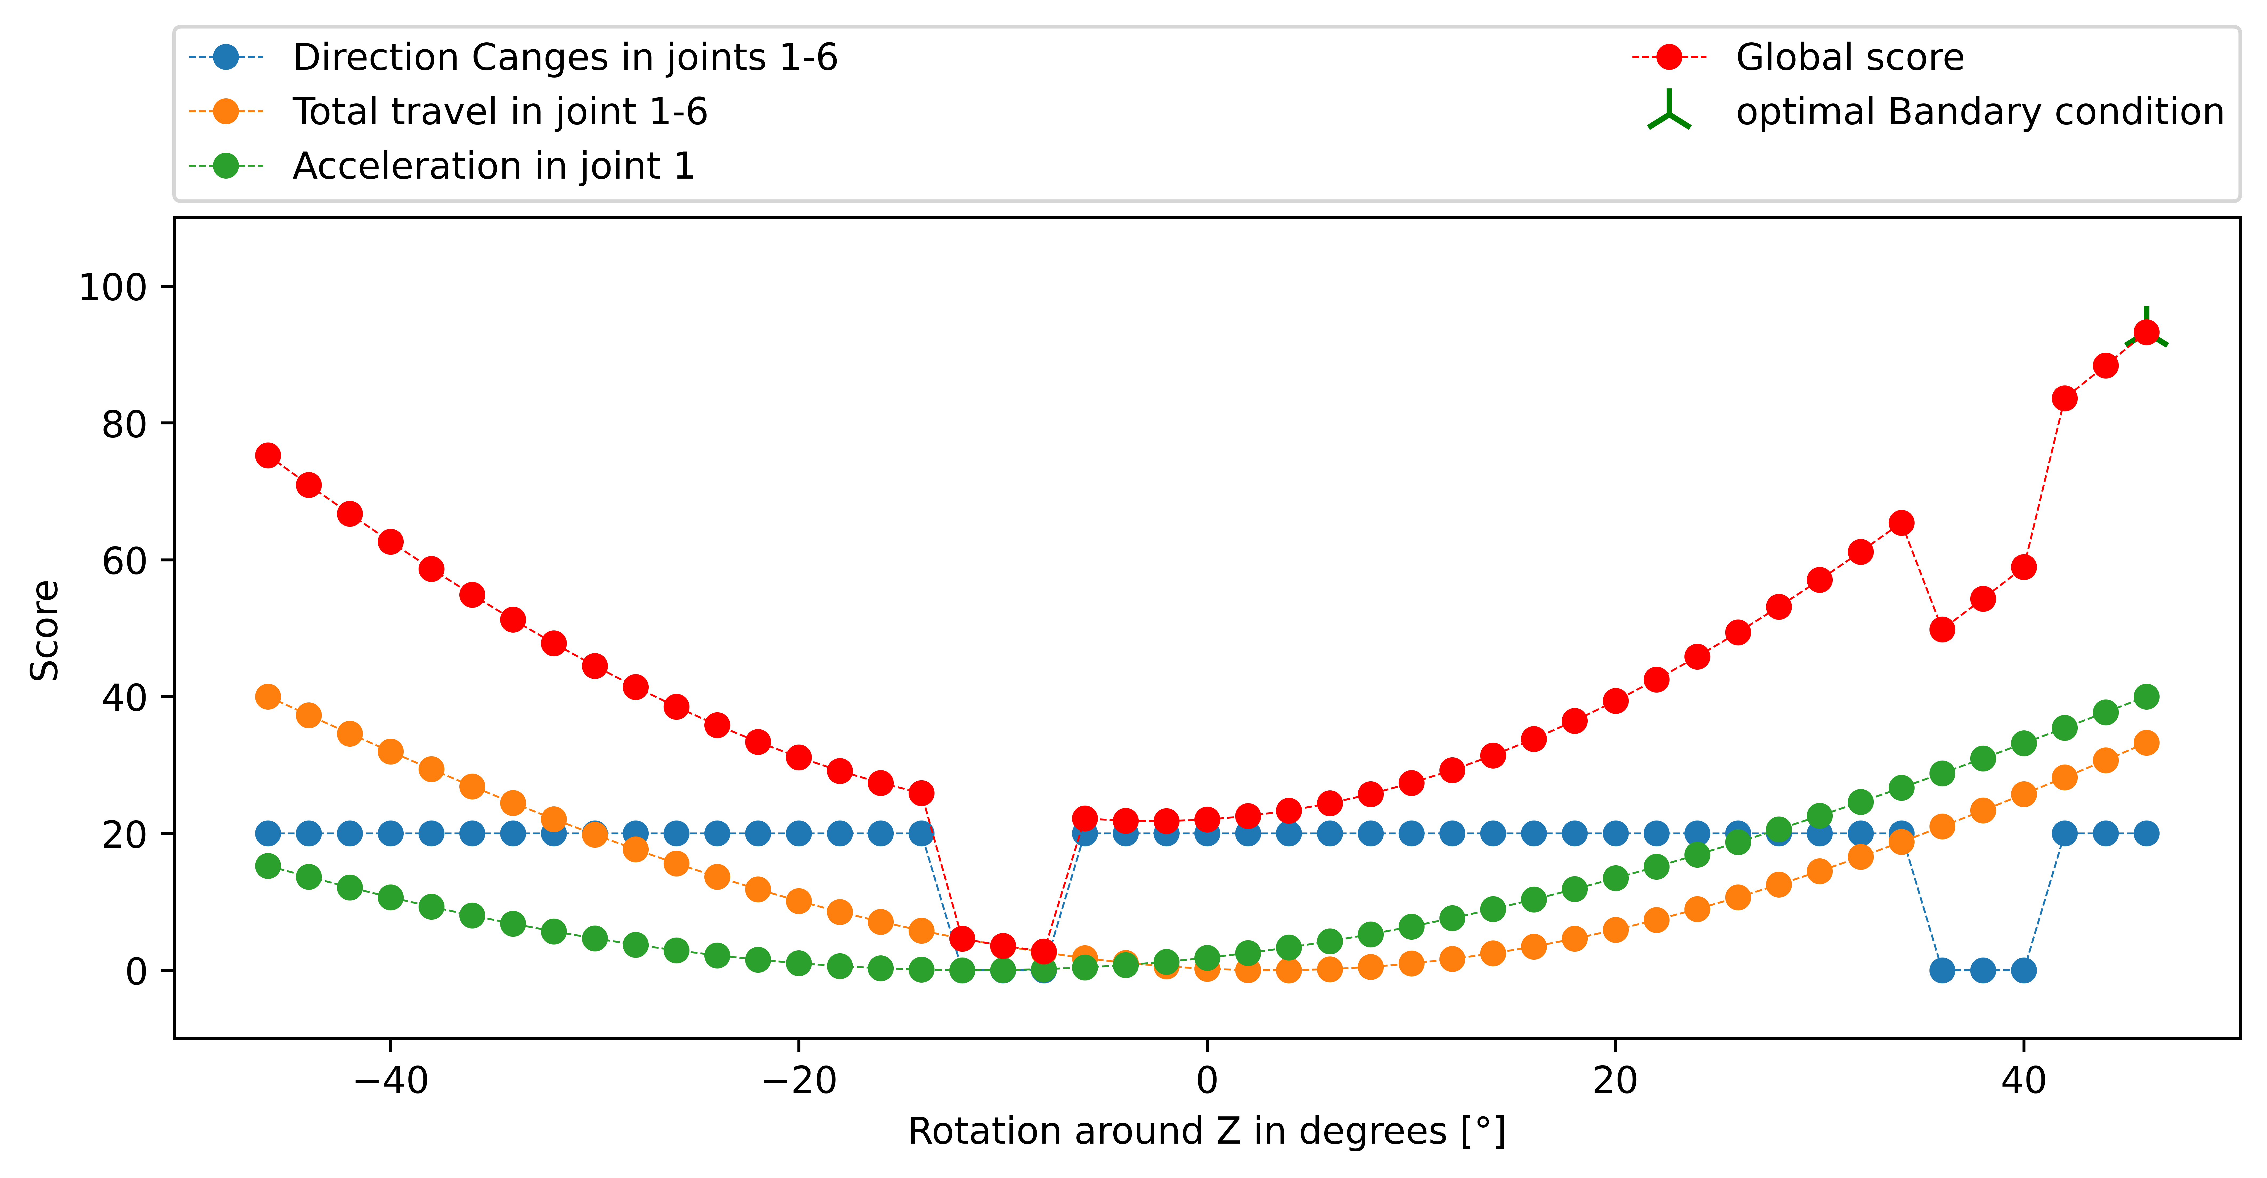
TP2
TP3
Why jumps in Direction changes ?????

Slide 11
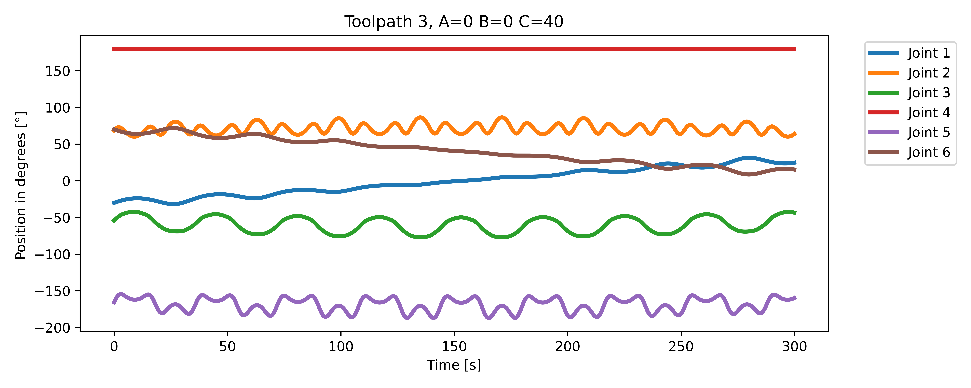
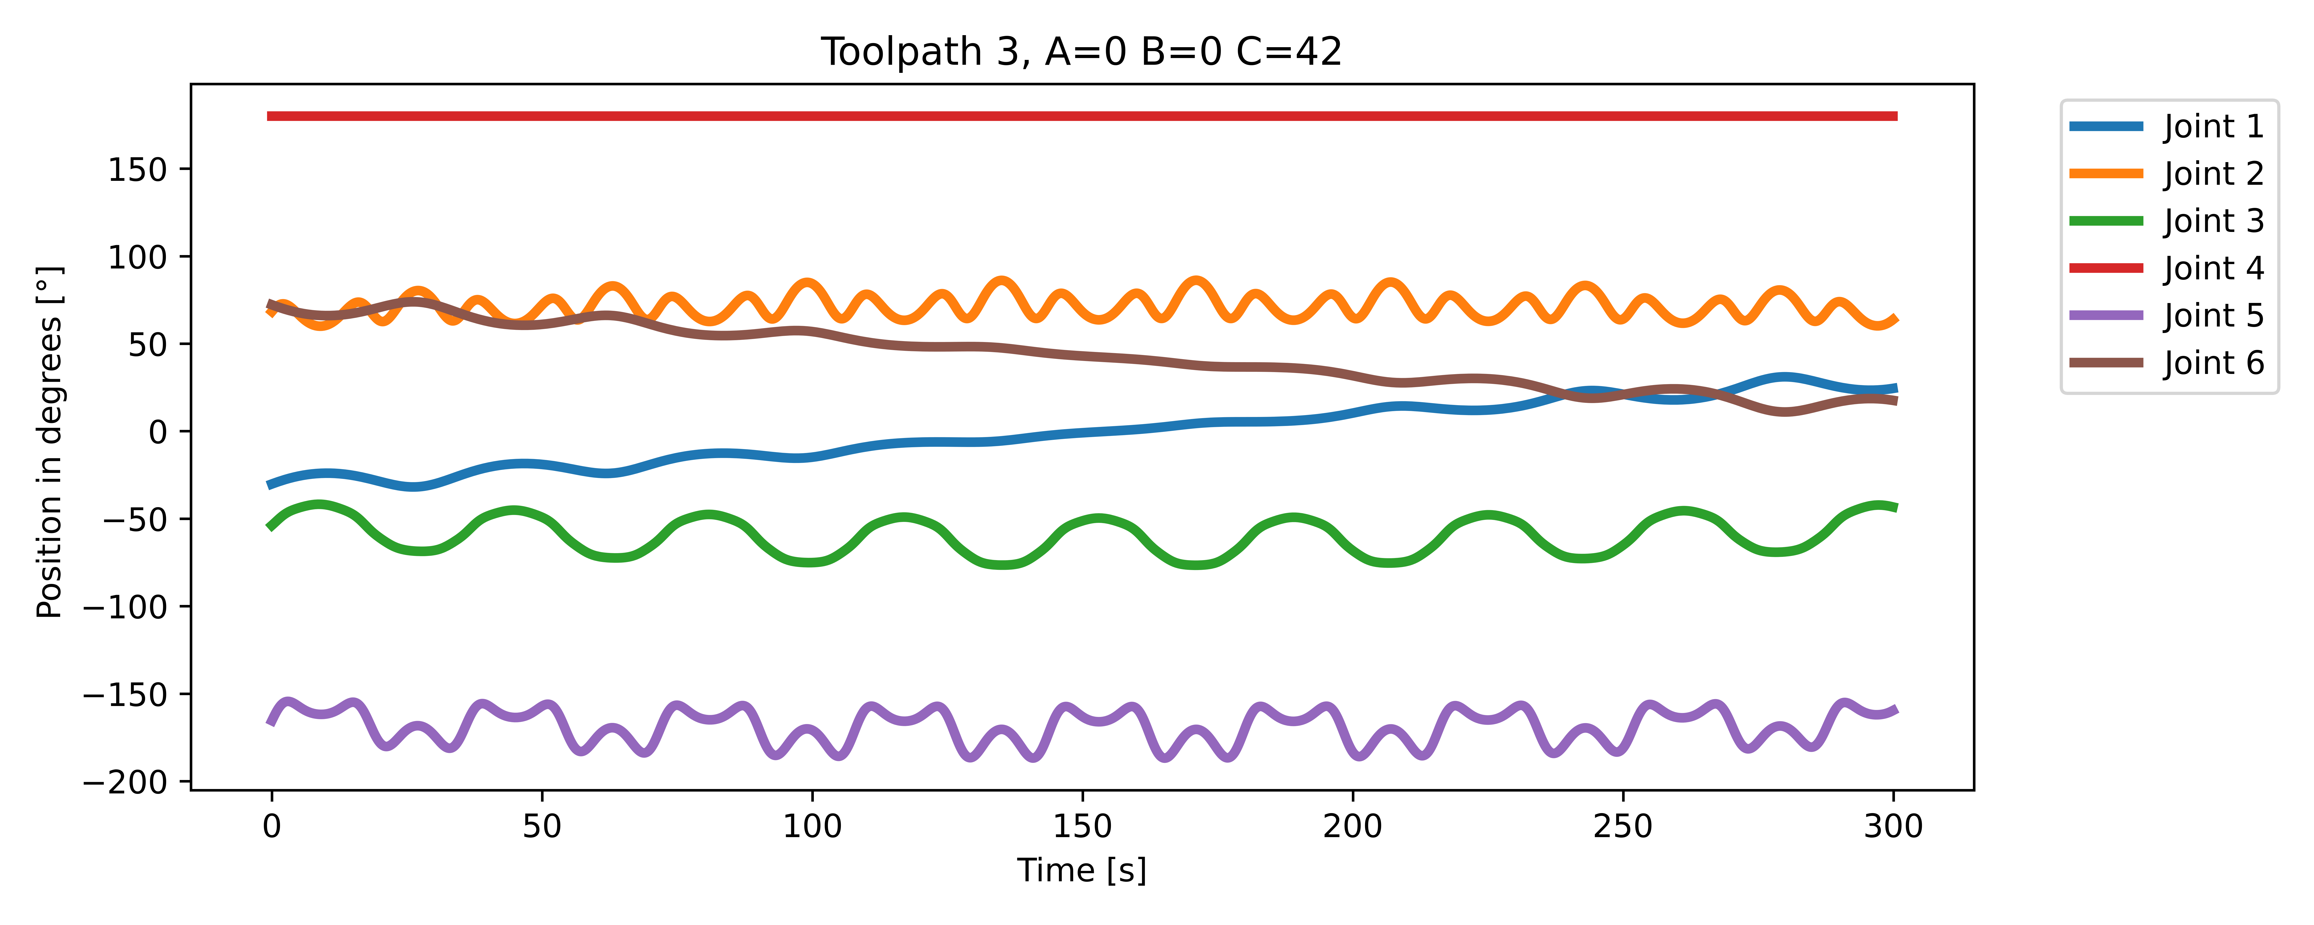
Somehow there a 4 more direction changes

Slide 12
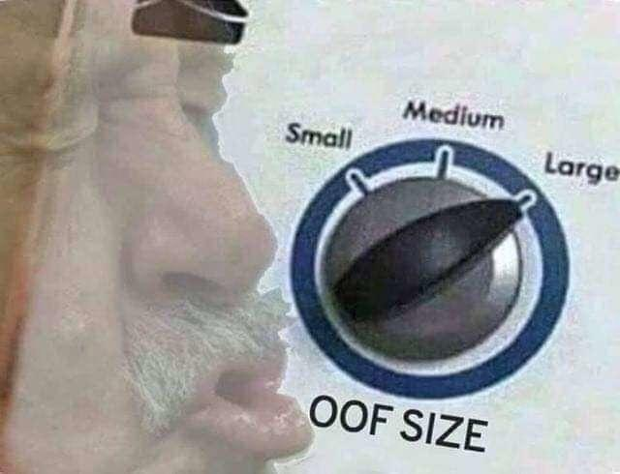
Big OOF
All previous calculations are useless
☹
New DH Params
New range -135° to 135° in 5° steps !

Slide 13
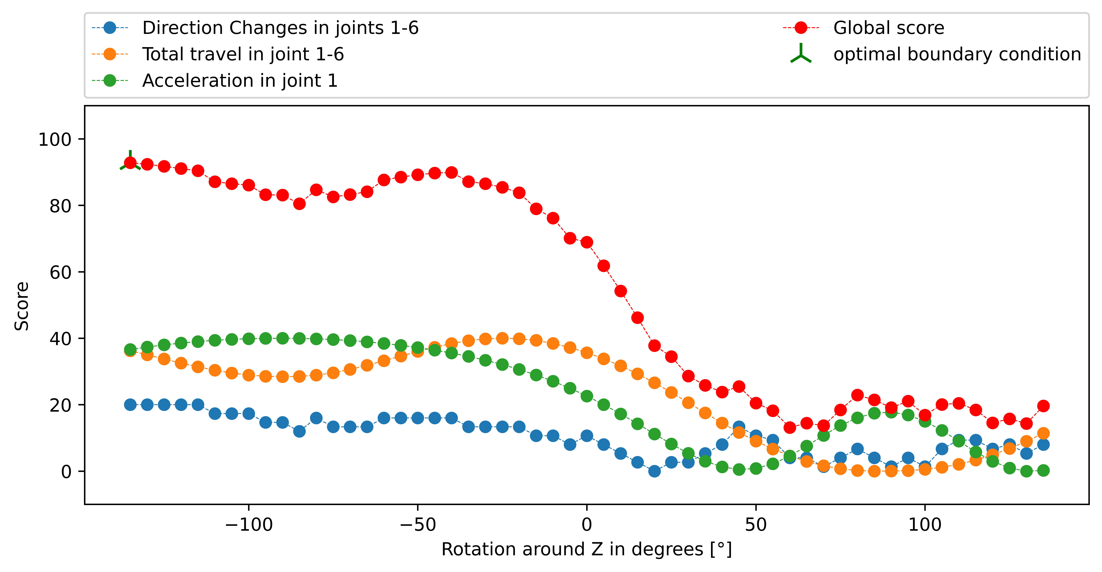
Result 1

Slide 14
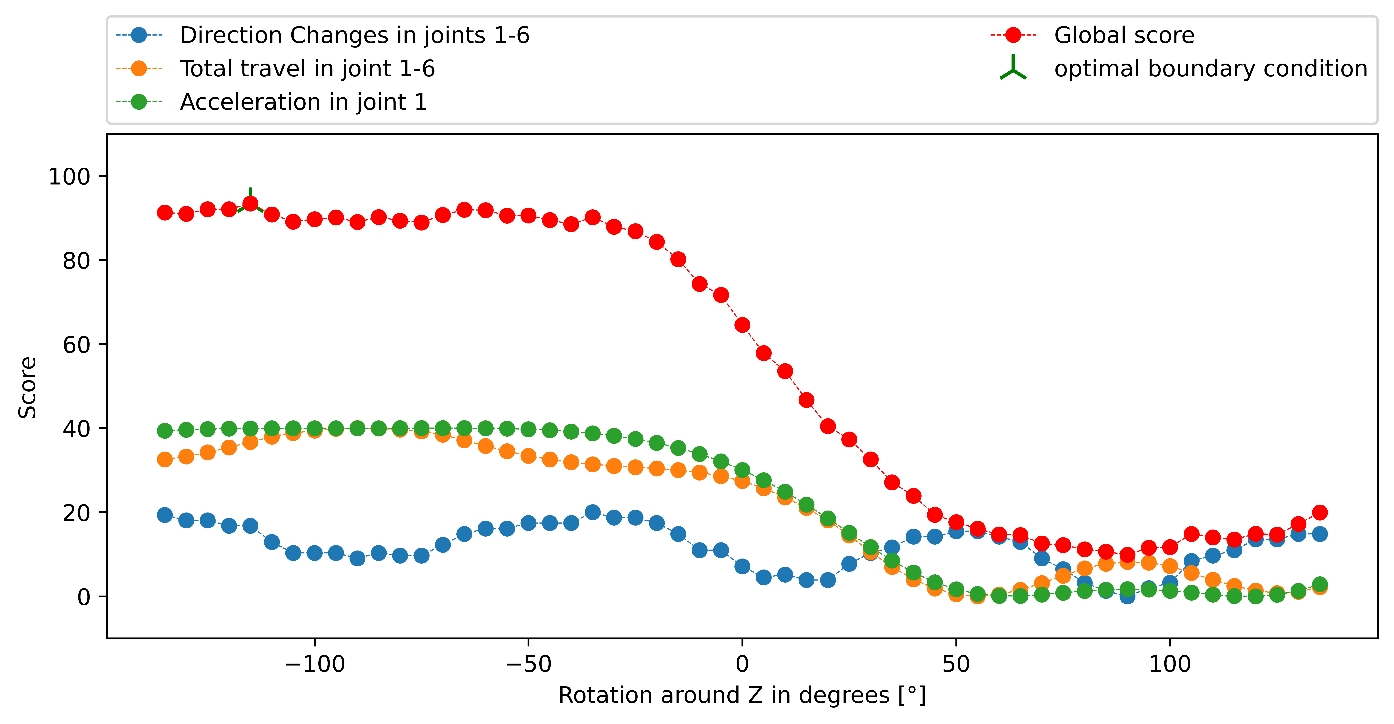
Result 2

Slide 15
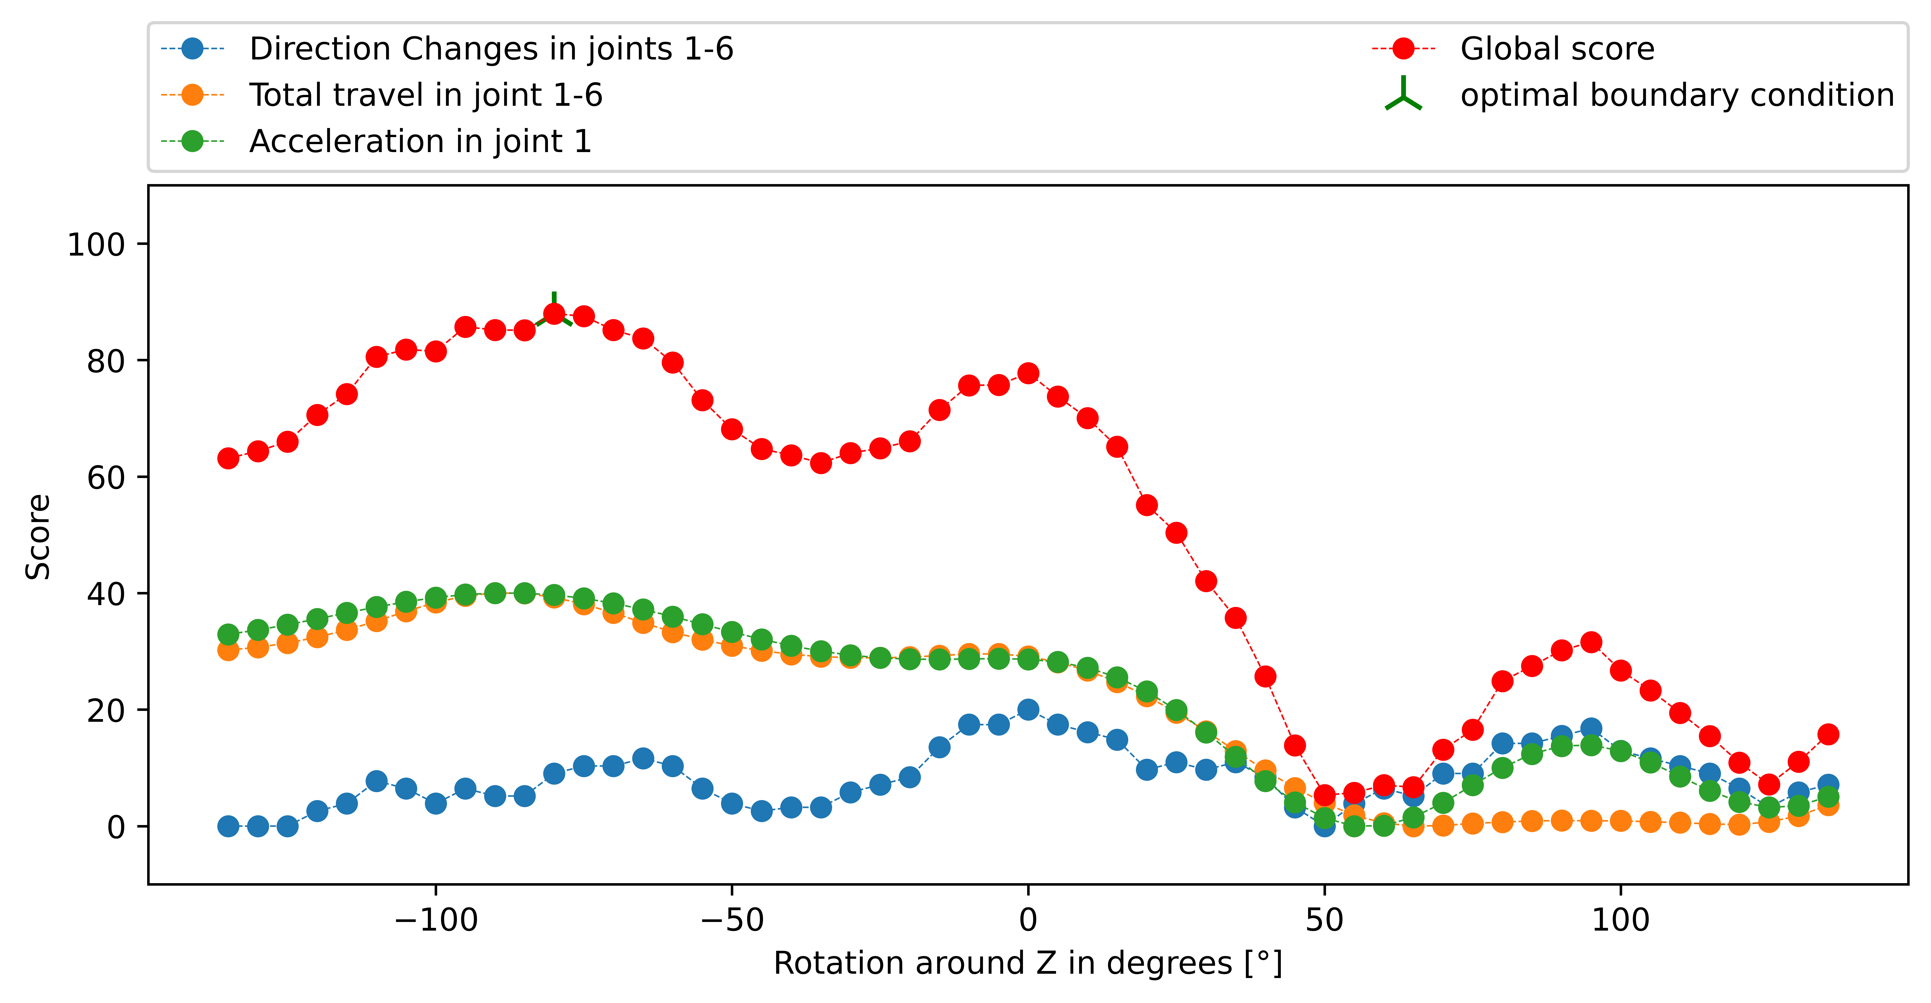
Result 3

Slide 16
Result 1+2

Slide 17
Result 3

Slide 18
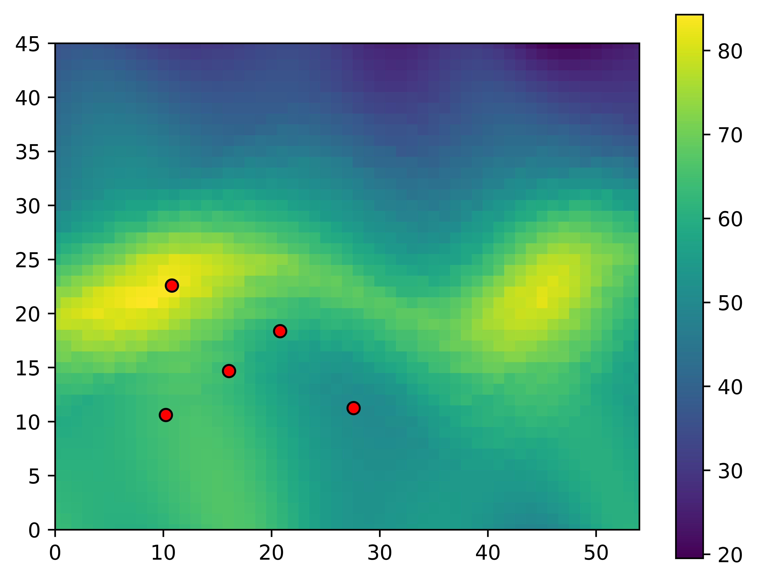
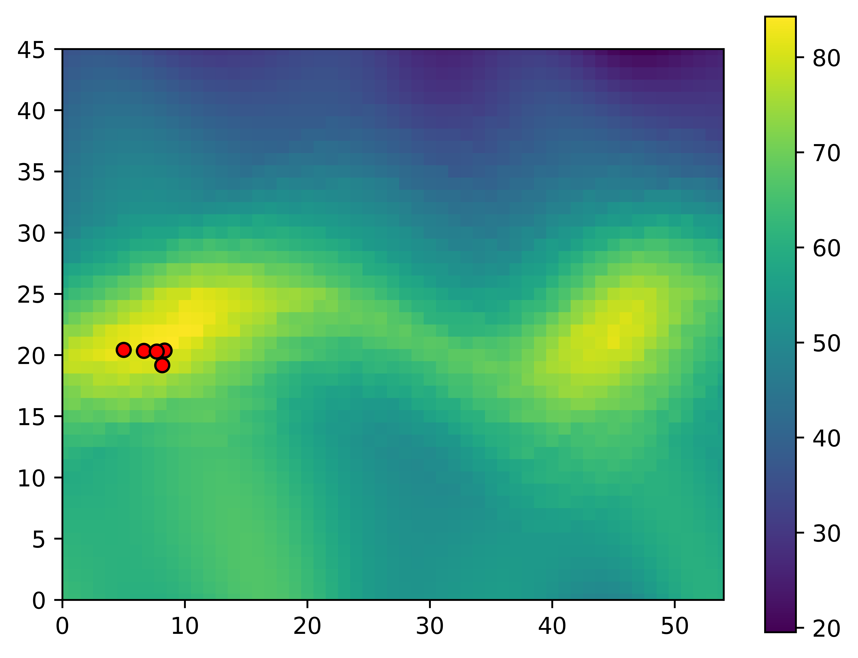
Swarm

Slide 19
Next Steps – Paper - Usecase

Slide 20
Contact
Jan Nalivaika (TUM) Student Otto-Hahn-Ring 6
81739 Munich, Germany
Phone +49 163 7180148
E-mail jan.nalivaika.ext@siemens.com nalivaika@outlook.de
Marius Breuer (Siemens AG)
Supervisor Otto-Hahn-Ring 6
81739 Munich, Germany
Phone +49 (172) 8396287
E-mail marius.breuer@siemens.com
Ludwig Siebert (TUM-IBW)
Supervisor Boltzmannstr. 15
85748 Garching at Munich
Phone +49 (89) 289 – 15578
E-mail ludwig.siebert@iwb.tum.de

Slide 21
Christmas planning
DATE: Ludwig Marius Jan
08.12 ☺
15.12 ☺
22.12 ☺
29.12 X ☺
05.01 ☺
12.01 ☺
19.01 X
26.01 X
02.02 ☺

Slide 22
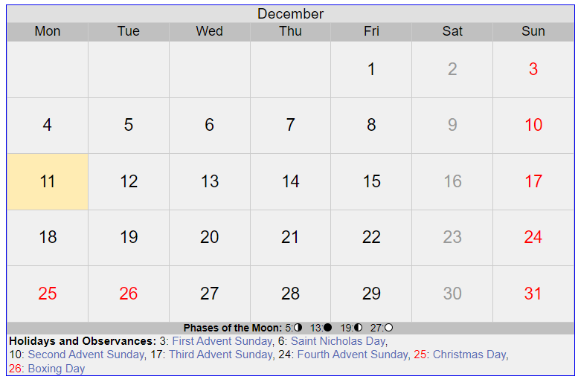
5 Tage
Dezember

Slide 23
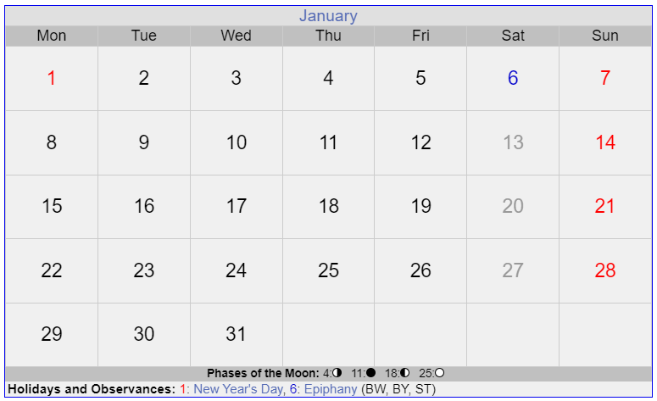
11 Tage
Januar

Slide 24
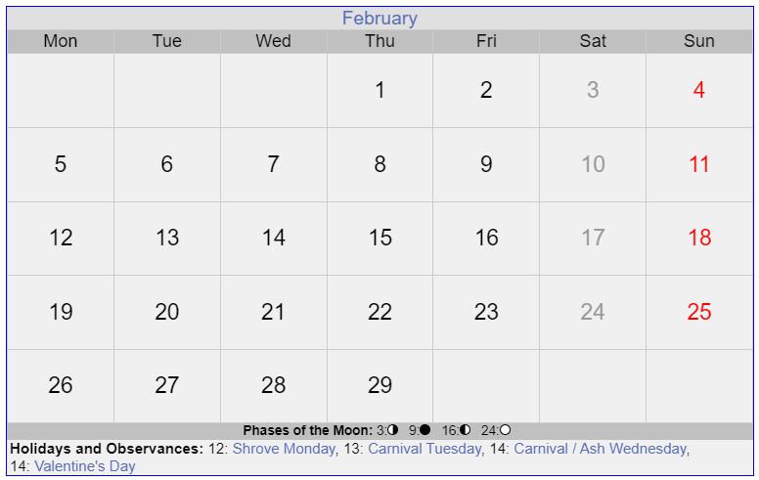
Final PDF
Paper
Paper
12 Tage
Januar

Slide 25
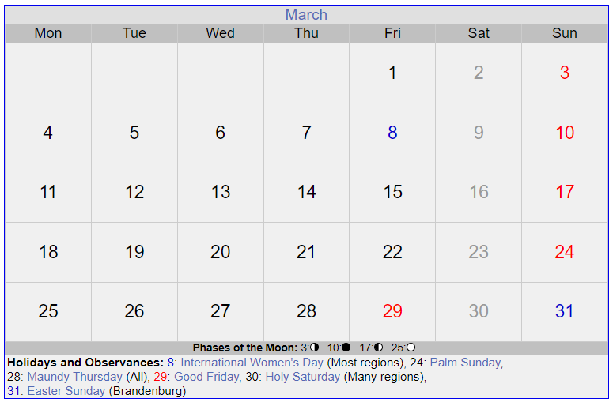
Paper
Paper
Verteidigung
PowerPoint für Verteidigung

